Slide 1
Modelling and Analysis of Human Behavior Impacts on Energy Systems during Crisis Events
Master Thesis of Isabella N. Grieser

Slide 2
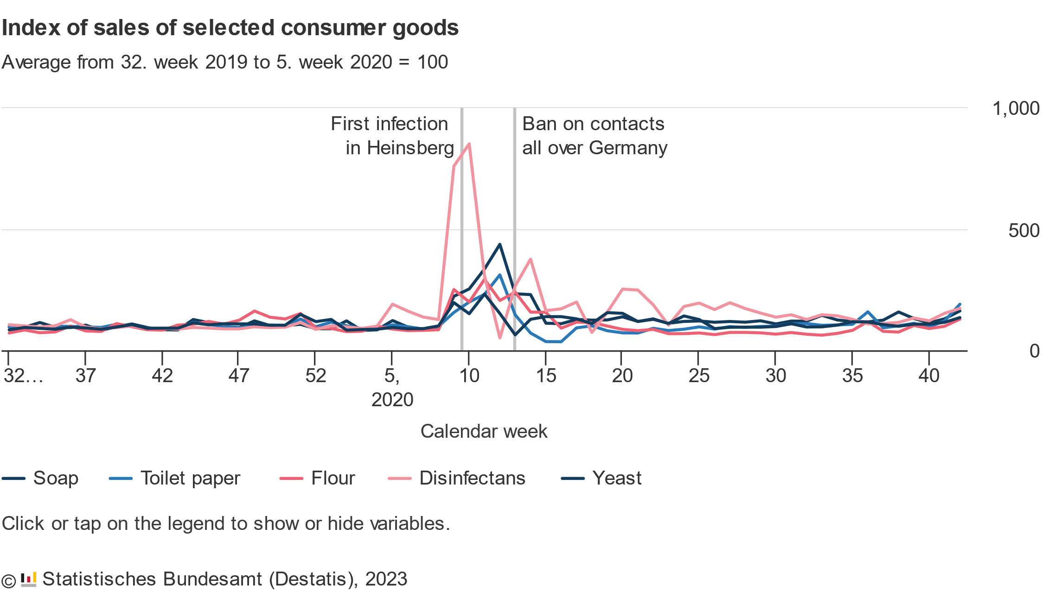
Panic Buying and Overconsumption became a very prominent topic during the COVID-19 Pandemic
Panic Buying: When consumers buy unusually large amounts of a product because of an unusual situation
During the COVID-19 Pandemic: People bought much greater number of disinfectants and soap in fear of the infectious disease.
Panic was amplified due to Information on Social Media
Notes:
Bessere storyline

Slide 3
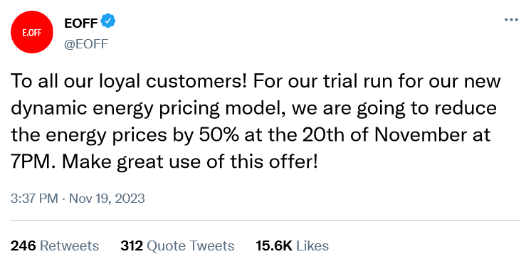
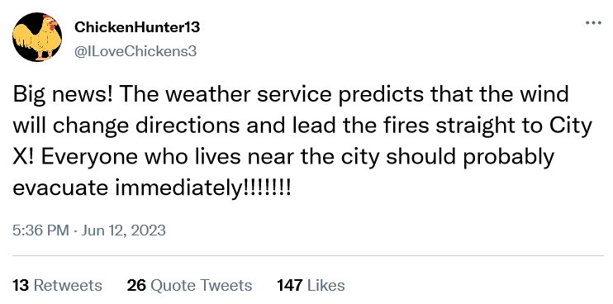
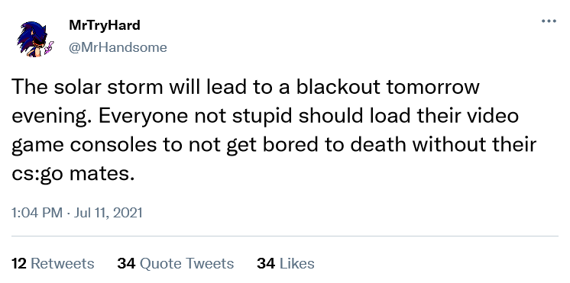
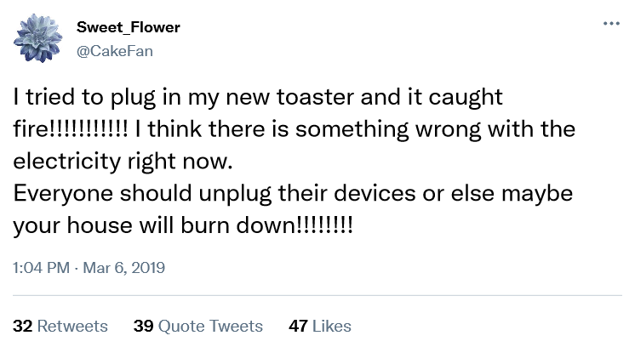
Could Social Media affect Power Demand?
Notes:
Bessere storyline

Slide 4
Some example Scenarios for changes in Electricity Consumption lead by Social Media
Demand Response Scenario:
A false advertisement for reduced electricity price for a limited time spreads through social media.
“Disconnect” Scenario:
Conspiracy theorists want to send a message by switching off all electrical appliances by a specified time.
Wildfire Scenario:
Rumors of a wildfire lead to people leaving the city in masses. But, to leave the city, they need to charge their electric vehicles first.
But: other scenarios could be imagined ….

Slide 5
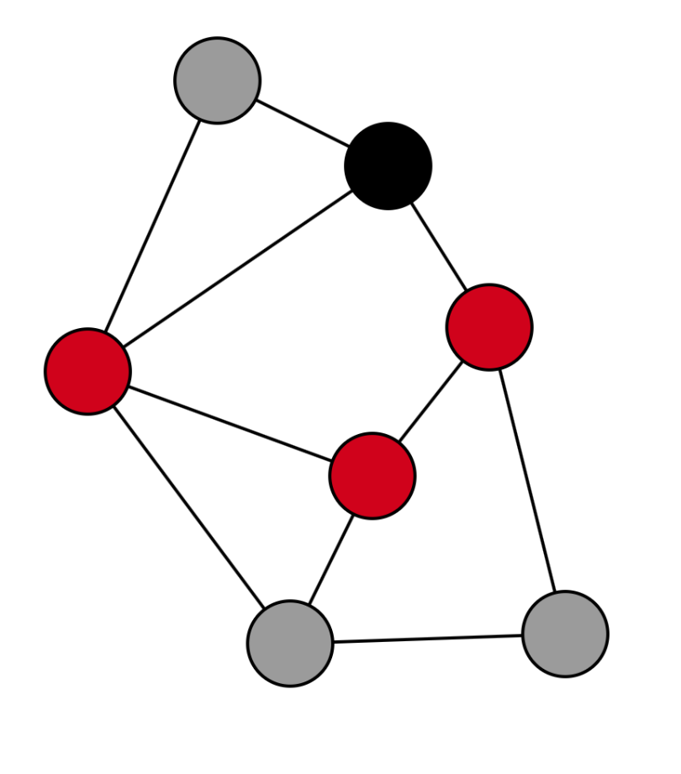

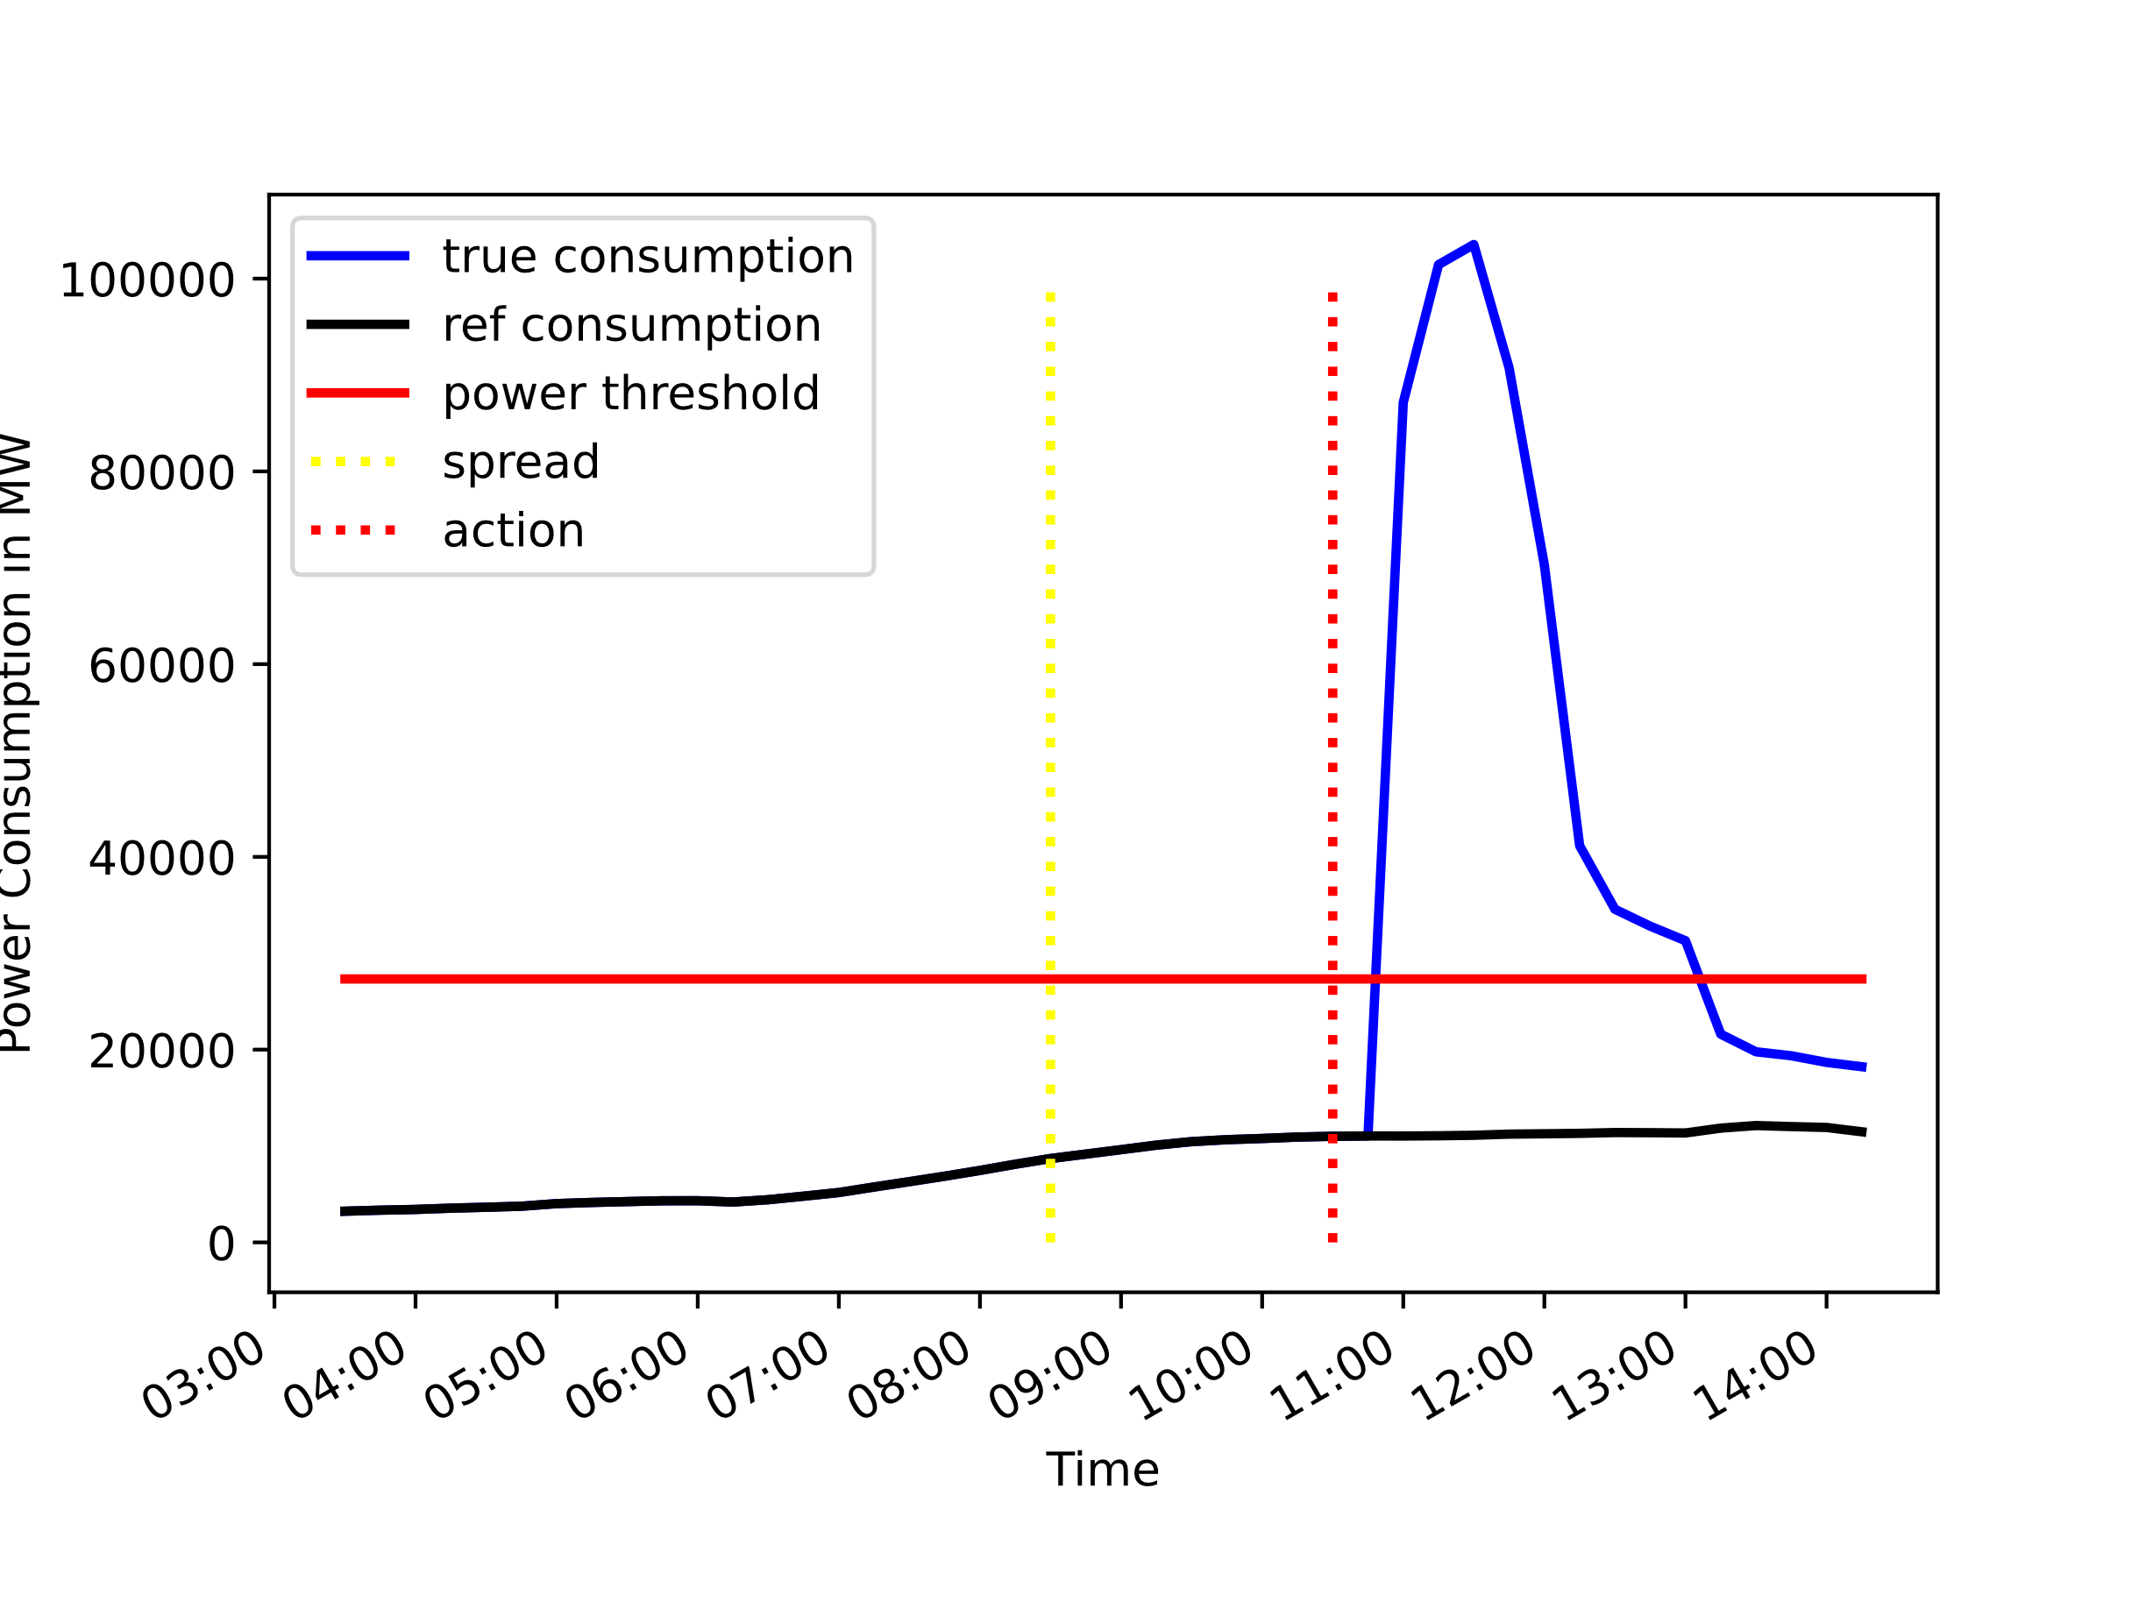
Idea: Analyze the Effects of Information Flow on the Power Grid
Create Social Media Graph
Model the Information Diffusion
Estimate the Power Demand

Slide 6

The Social Media Network Graph is modelled via Random Graph Algorithms
Graph model used to model social media networks ➔ Barabási–Albert model
Small world characteristic
Scale-free networks
Highly clustered
The SIR model is used to model the information propagation process:
Three states:
Susceptible (S)
Infected (I)
Recovered (R)
Neighbors are predominantly infected ➔ node becomes infected
Neighbors are predominantly recovered ➔ node recovers
Notes:
Modell genauer erklären -> was ist meine contribution
Gif von state changes sir
Betonen: epidemologisches Modell -> information ist eine infektion

Slide 7




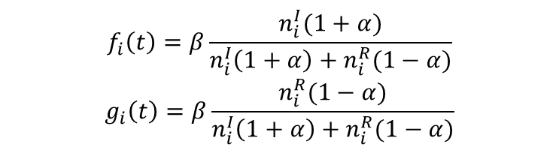


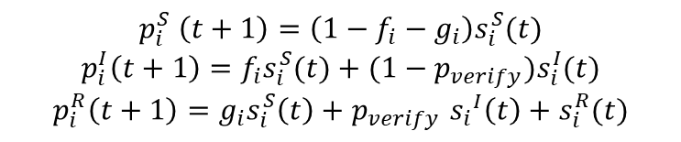
Formulas of the SIR model
State Chart:
$${1−g}_{neighbors}−f_{neighbors}$$
Susceptible
$$g_{neighbors}$$
$$f_{neighbors}$$
Recovered
Infected
$$p_{verify}$$
$$1$$
$$1−p_{verify}$$
$$f_{i}\left(t\right)=β\frac{n_{i}^{I}(1+α)}{n_{i}^{I}\left(1+α\right)+n_{i}^{R}(1−α)}$$
$$g_{i}\left(t\right)=β\frac{n_{i}^{R}(1−α)}{n_{i}^{I}\left(1+α\right)+n_{i}^{R}(1−α)}$$
$$p_{i}^{S} \left(t+1\right)=\left(1−f_{i}−g_{i}\right)s_{i}^{S}(t)$$
$$p_{i}^{I}\left(t+1\right)=f_{i}s_{i}^{S}(t)+(1−p_{verify})s_{i}^{I}(t)$$
$$p_{i}^{R}\left(t+1\right)=g_{i}s_{i}^{S}\left(t\right)+p_{verify} {s_{i}}^{I}\left(t\right)+s_{i}^{R}(t)$$
Notes:
Graphbasiertes sir erklären

Slide 8
Simulation Rules to analyze the Effects on the Power Grid
Assumptions
Each node in the social media graph represents one (physical) household
The effect of the information may have a delayed response on the electrical grid
Simulation Steps
Start with one source of information
For each iteration step
Calculate the power used in the network
Propagate the information in the graph
Power Calculation
Each household may have electrical appliances and may activate them based on if they possess the specific appliances
Notes:
Power calculation auch gut erklären
Und assumption
Zweite assumption nicht erklären

Slide 9
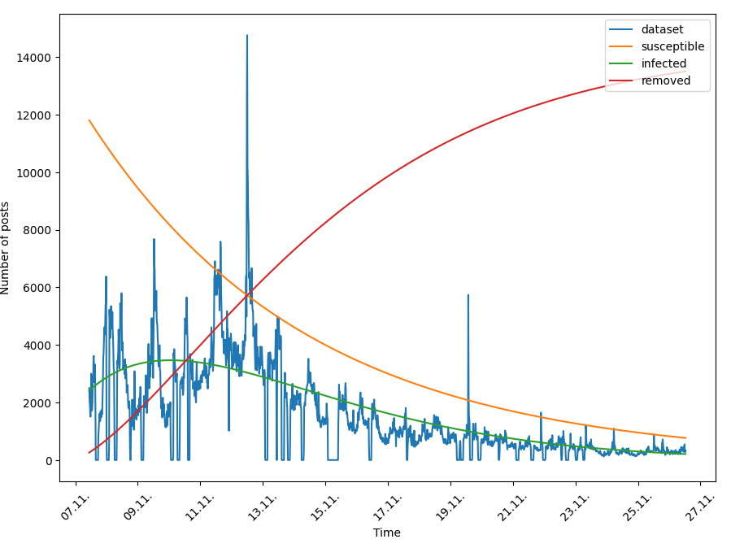
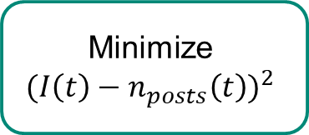
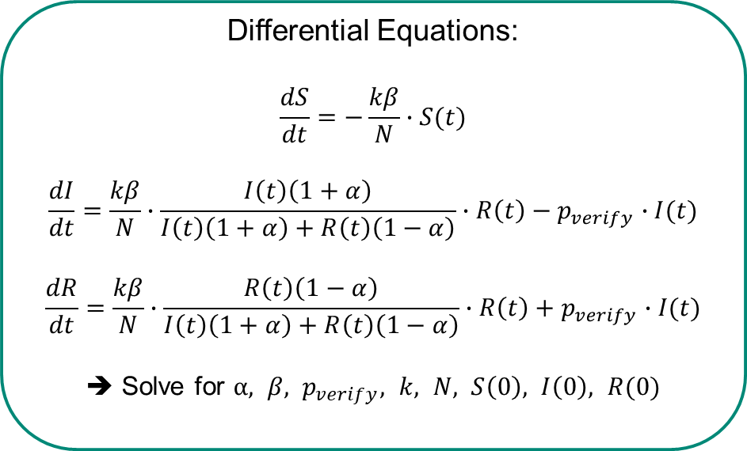
Social Media Data can be used to estimate Simulation Parameters
Count Social Media Posts over a Timespan
Smoothen Data Plot
Minimize
$${(I\left(t\right)−n_{posts}\left(t\right))}^{2}$$
Solve Differential Equations
Differential Equations:
$$\frac{dS}{dt}=−\frac{kβ}{N}∙S(t)$$
$$\frac{dI}{dt}=\frac{kβ}{N}∙\frac{I\left(t\right)\left(1+α\right)}{I\left(t\right)\left(1+α\right)+R\left(t\right)\left(1−α\right)}∙R\left(t\right)−p_{verify}∙I(t)$$
$$\frac{dR}{dt}=\frac{kβ}{N}∙\frac{R\left(t\right)\left(1−α\right)}{I\left(t\right)\left(1+α\right)+R\left(t\right)\left(1−α\right)}∙R\left(t\right)+p_{verify}∙I(t)$$
➔ Solve for $α, β, p_{verify}, k, N, S\left(0\right), I\left(0\right), R(0)$
Notes:
Mean field theory

Slide 10
Proposal for a Prediction Framework
Collect Social Media Posts
Predict Model Parameters
Run Simulation
Power Demand critical?
Yes/No

Slide 11
Case Studies

Slide 12
Scenario 1: Demand Response Scenario
Assumptions:
Many people believe and will act on the information
Infected entities have a delayed response, acting after the time specified in the social media message
Infected entities will turn on many energy-intensive appliances (dishwasher, washing machine, …) in their households
Number of entities: 1000, time resolution: 15 minutes
Social media data is used to estimate the information propagation parameters
Demand Response Scenario:
A false advertisement for reduced electricity price for a limited time spreads through social media.
Notes:
Ladeleistung erlkären
Anzahl an entities nennen

Slide 13
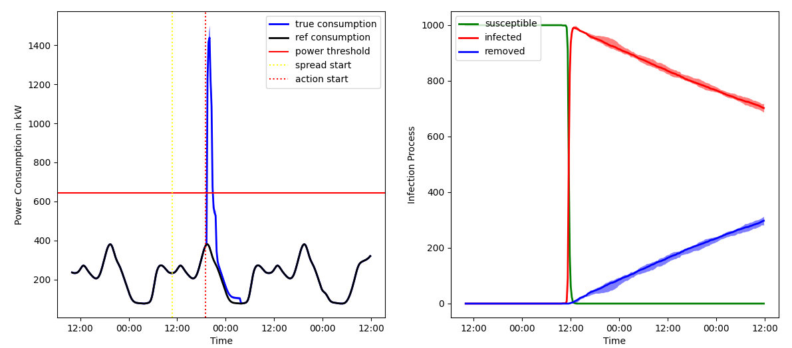
Scenario 1: Demand Response Scenario
Notes:
Animation wegmachen :(

Slide 14
Scenario 2: “Disconnect” Scenario
“Disconnect” Scenario:
Conspiracy theorists want to send a message by disconnecting all electrical appliances by a specified time.
Assumptions:
Not many entities will act on the information
The infected entities will have a delayed response to the information
The infected entities will disconnect all devices, e.g., their power consumption is 0
Infected entities do not recover from the information

Slide 15
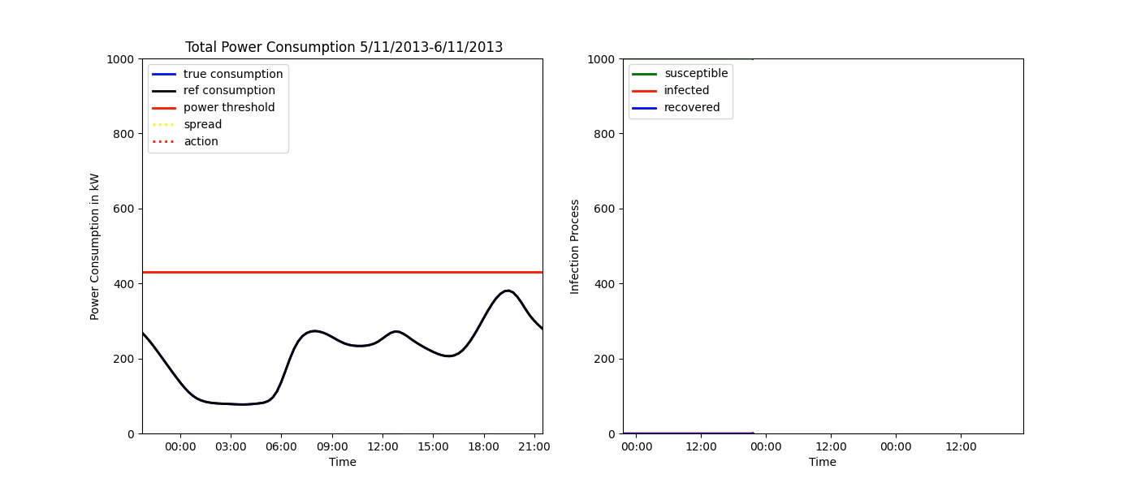
Scenario 2: “Disconnect” Scenario

Slide 16
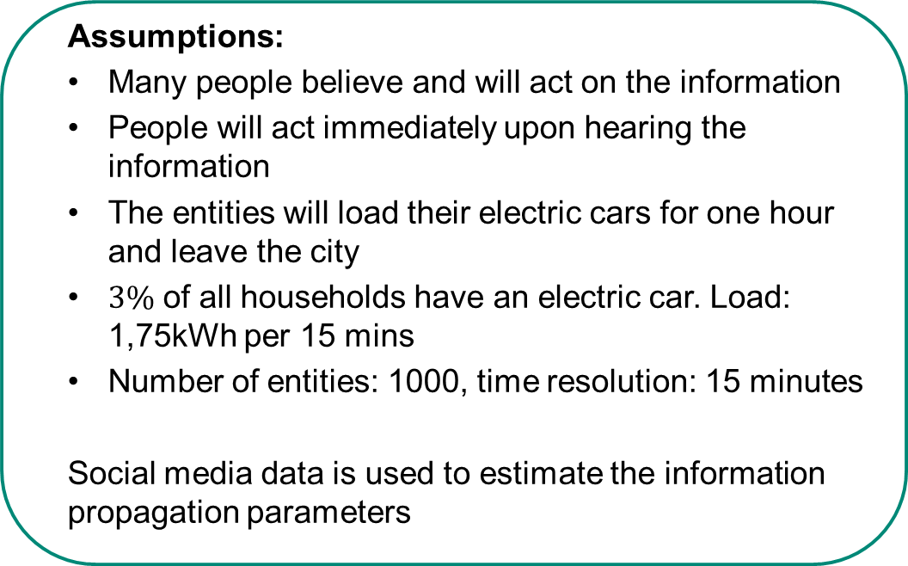
Scenario 3: Wildfire Scenario
Assumptions:
Many people believe and will act on the information
People will act immediately upon hearing the information
The entities will load their electric cars for one hour and leave the city
$3\%$ of all households have an electric car. Load: 1,75kWh per 15 mins
Number of entities: 1000, time resolution: 15 minutes
Social media data is used to estimate the information propagation parameters
Wildfire Scenario:
Rumors of a wildfire lead to people leaving the city in masses. But, to leave the city, they need to charge their electric vehicles first.
Notes:
Ladeleistung erlkären
Anzahl an entities nennen

Slide 17
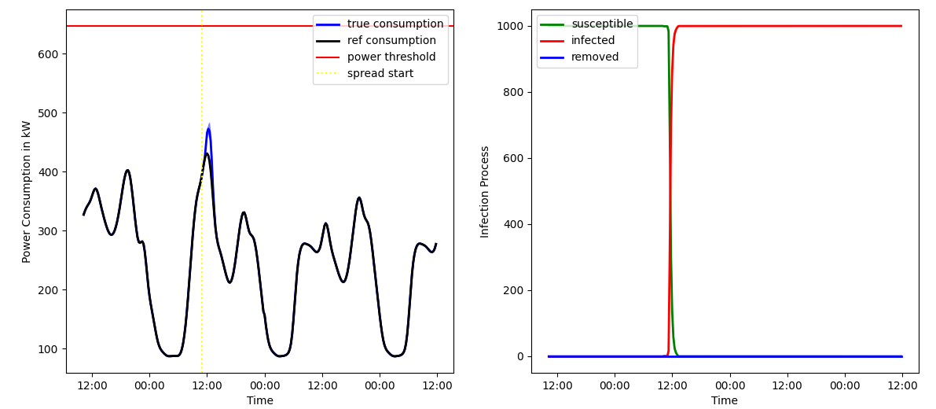
Scenario 3: Wildfire Scenario

Slide 18
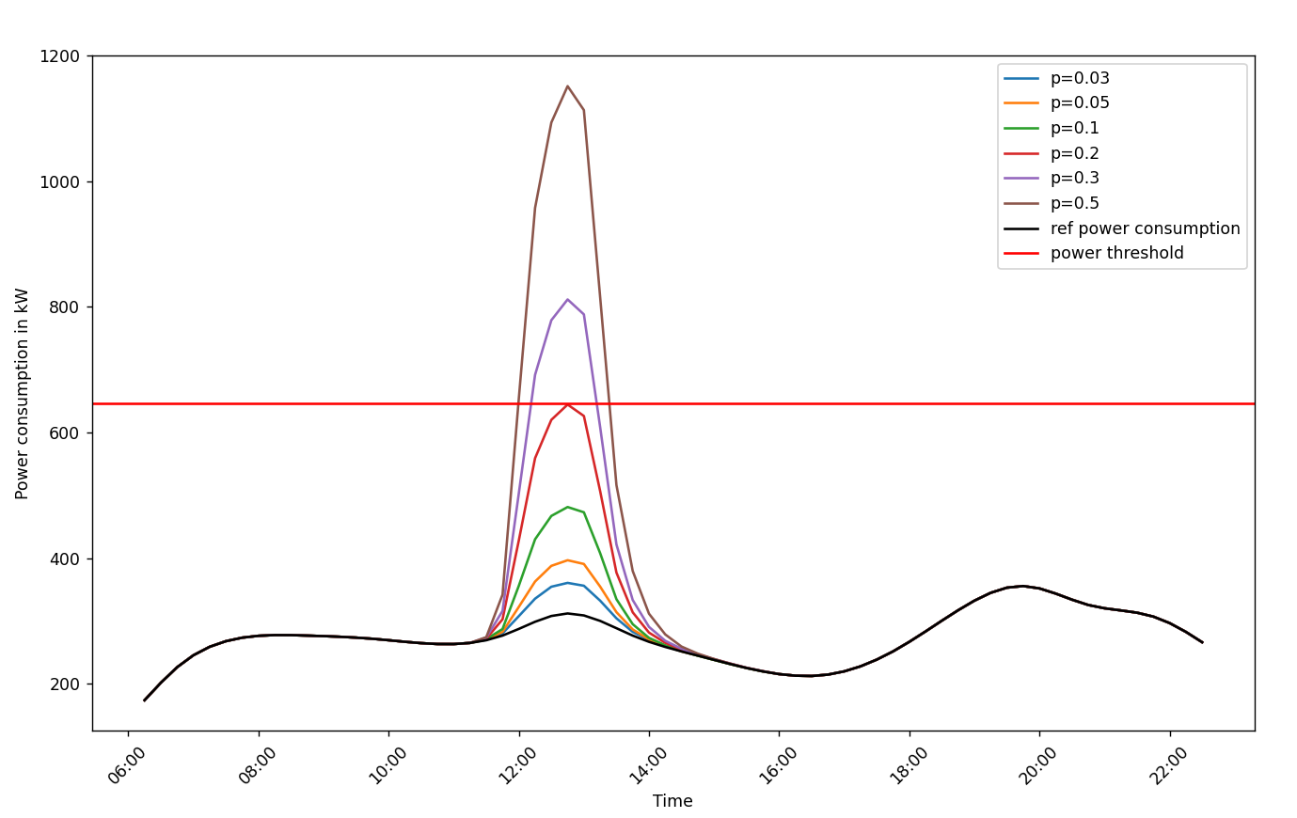
Scenario 3: Wildfire Scenario: change the adoption rate

Slide 19
Conclusion
Synchronization events caused by information on social media could be critical to the power grid
Increasing adoption of new, highly power-consuming technologies could increase the peak power demand caused by synchronization

Slide 20
Questions?

